Slide 1
AutoAI Model for Diabetes Prediction Using IBM Watson Studio
This presentation explores an AI-powered predictive model for early diabetes detection, leveraging the advanced capabilities of IBM Watson Studio’s AutoAI. Our focus is on improving healthcare outcomes through intelligent automation.

Slide 2



The Challenge: Diabetes Prediction
Globally, 425 million people live with diabetes. Early detection is critical to prevent severe complications, yet traditional diagnosis faces delays and data complexities. AI offers a powerful solution for accurate and timely risk prediction.
Global Impact
Timely Detection
Data Complexity
425M people worldwide affected.
Crucial for preventing complications.
Traditional methods struggle with large datasets.

Slide 3

Goal of the Project
The overall goal of this project is to develop an accurate and automated machine learning model that can predict the likelihood of diabetes in patients based on medical and demographic features.
By using IBM Watson Studio's AutoAI, the project aims to streamline the model-building process—automating tasks like data preprocessing, feature engineering, model selection, and hyperparameter tuning.
The ultimate objective is to assist healthcare professionals in early diagnosis and risk assessment of diabetes, enabling timely intervention and improved patient outcomes.

Slide 4

Dataset and Key Features
The model is built on a synthesized version of the Pima Indians Diabetes Database, ensuring patient privacy. Key features include Pregnancies, Glucose, Blood Pressure, and BMI, all crucial for accurate prediction. Data preprocessing handled missing values and refined features.

Slide 5
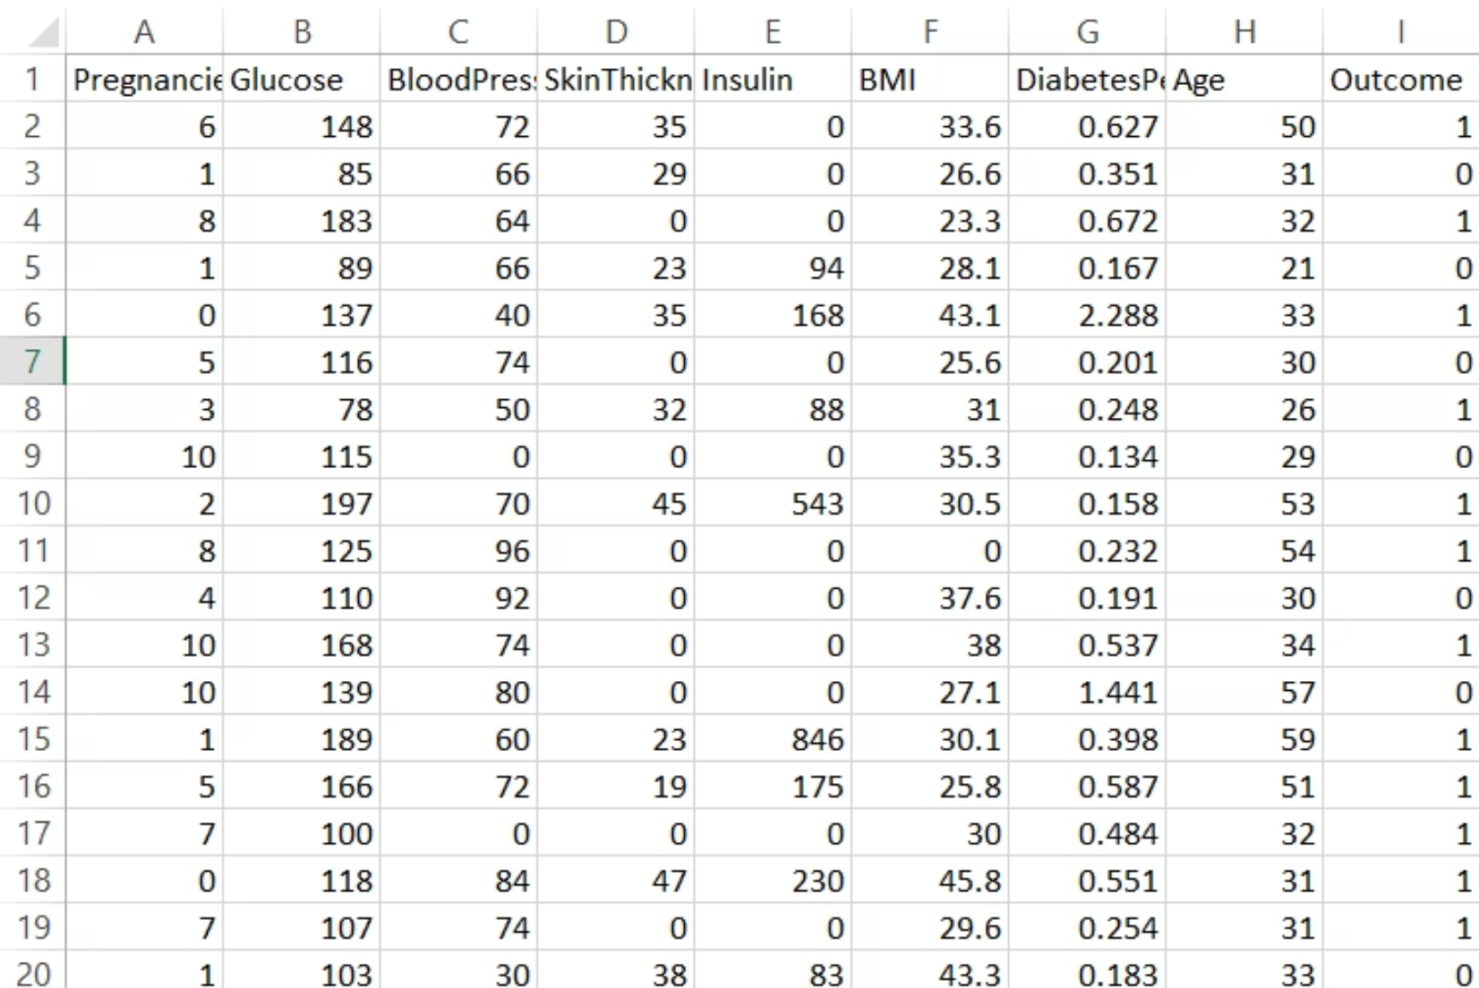
Data Exploration
Each row represents a patient record, and the columns represent key medical attributes related to diabetes risk.The columns include features like Pregnancies, Glucose level, Blood Pressure, Skin Thickness, Insulin, BMI, Diabetes Pedigree Function, Age, and the target column Outcome.The Outcome column is binary (0 or 1), where 1 indicates the presence of diabetes and 0 indicates absence.
Target: Outcome (0 = No Diabetes, 1 = Diabetes)

Slide 6



AutoAI Workflow in IBM Watson Studio
IBM Watson Studio's AutoAI streamlines the entire machine learning pipeline. Users simply upload their dataset and specify the prediction target. AutoAI then automates data preparation, feature engineering, model selection, and hyperparameter optimization.
Upload Data
Automate Processes
Model Ranking
Effortlessly upload dataset.
Auto-prep and feature engineer.
Leaderboard for best models.

Slide 7
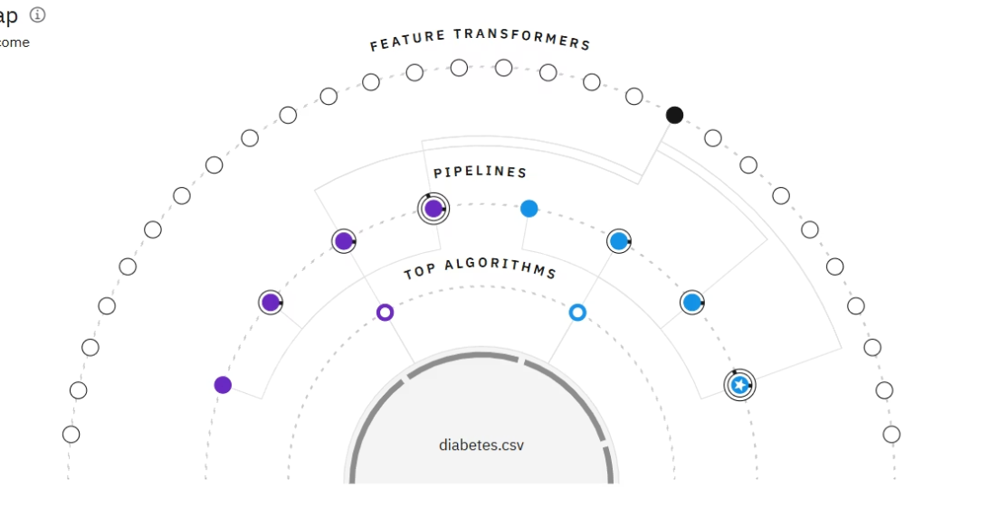
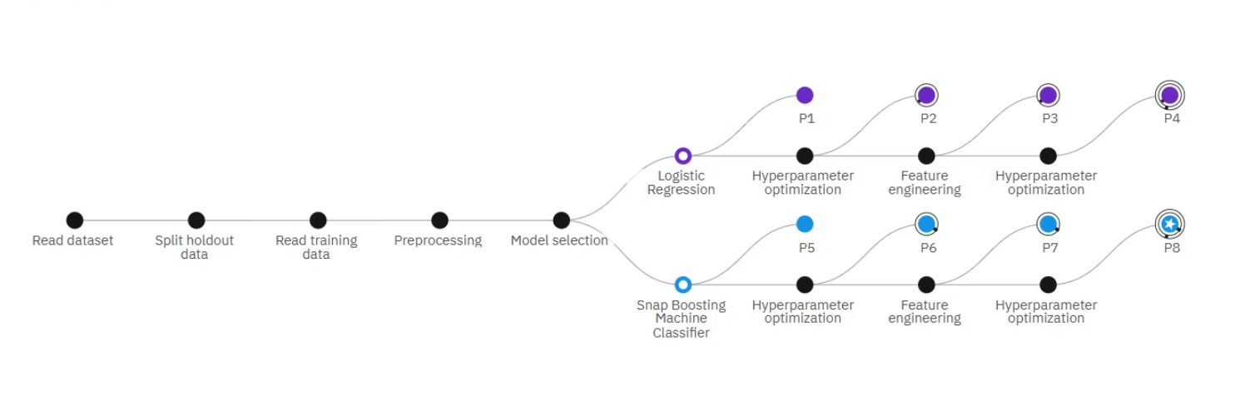
Model Building and Evaluation
Progress Pipeline Map:
Circular Relationship Map:
The linear progress map shows the end-to-end pipeline flow:
The circular relationship map presents a holistic view of the experiment:
Starts from reading the dataset → splitting data → preprocessing → model selection.
The center starts with the diabetes.csv dataset.
Radiating outward, it shows:
Two main algorithms are selected: Logistic Regression and Snap Boosting Machine Classifier.
Top algorithms used.
The pipelines generated.
Each algorithm undergoes multiple rounds of:
Feature transformers that contributed to better performance.
Hyperparameter optimization – tuning model settings.
It helps visualize the interconnections between models, data, and transformations.
Feature engineering – transforming data for better accuracy.
Eight pipelines (P1 to P8) were created.
Pipeline P8 (starred) again stands out as the top-ranked model based on accuracy.
Pipeline P8 (Snap Boosting) is marked with a star, indicating it gave the best performance.

Slide 8
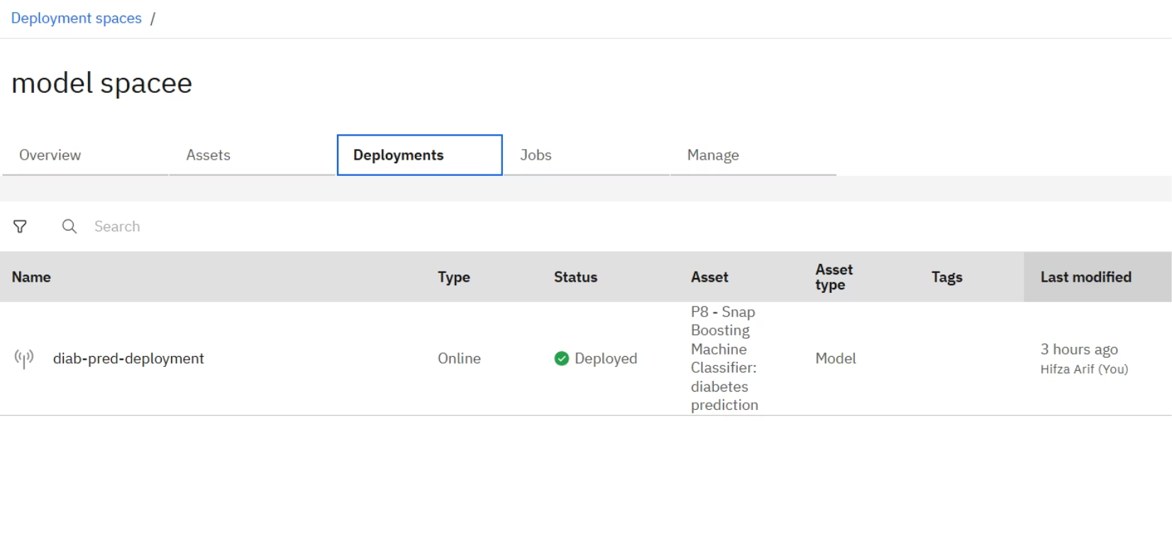
Deployment with Watson Machine Learning
The finalized model is securely deployed as a web service via Watson Machine Learning on IBM Cloud. This enables real-time diabetes risk prediction through API integration, ensuring scalable and reliable access. l.

Slide 9
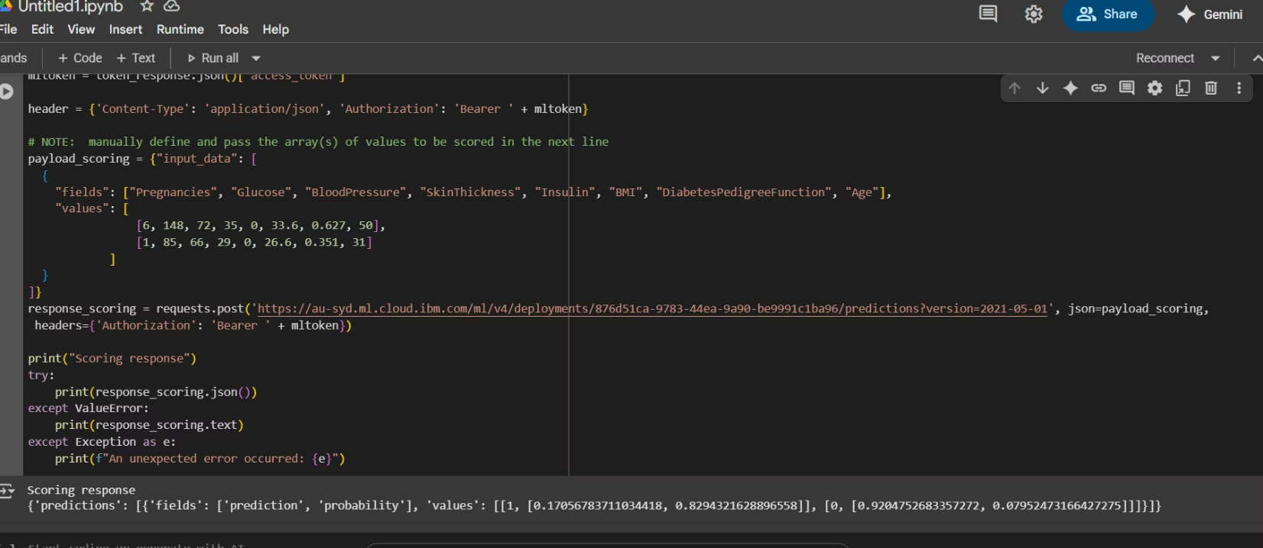
Deployment in Colab Notebook
Once deployed, an API endpoint is generated, which allows external applications to send data for prediction.
In Colab, you can use Python’s requests library to send a POST request with input data to the deployment URL.
Authentication is handled by generating an access token using your IBM Cloud API key via the IAM token service.
The response from the API will return predicted outcomes, which can be parsed and used in your notebook for analysis or visualization

Slide 10
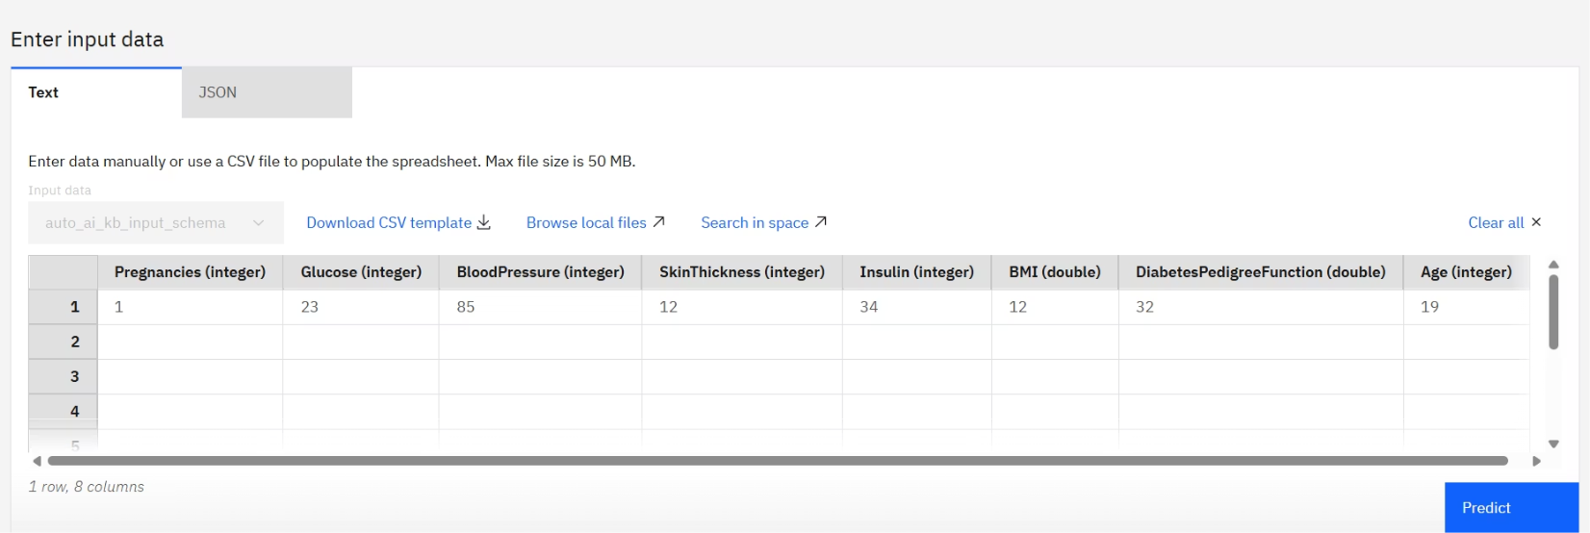
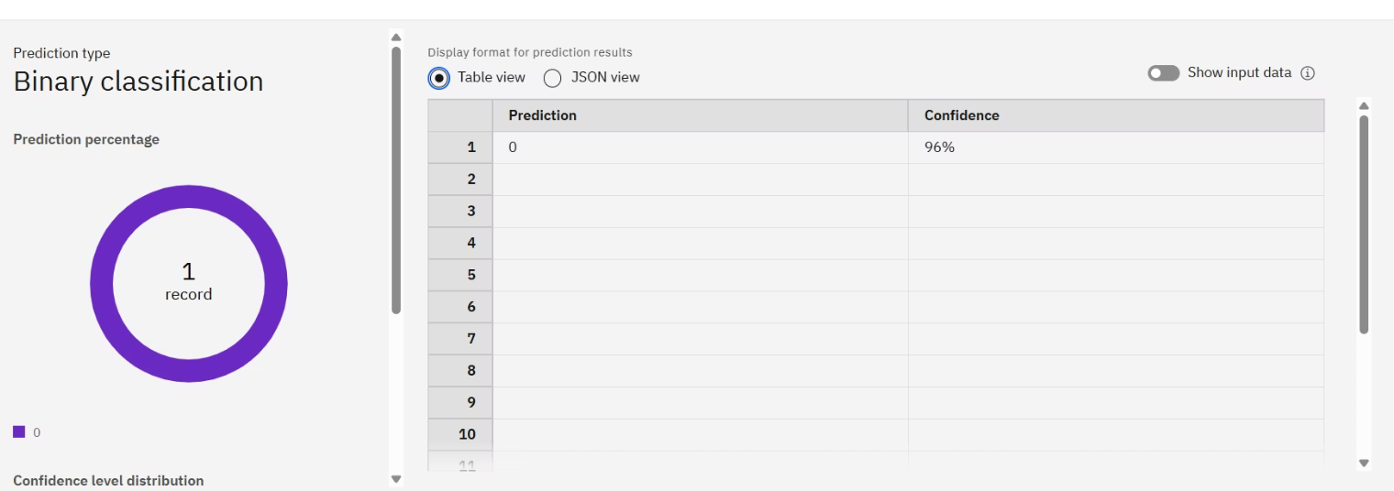
Model Testing
Enter input
Prediction

Slide 11

Conclusion and Future Directions
Integrate with mobile apps for real-time predictions
Collaborate with healthcare providers for real-world deployment
Successfully deployed a diabetes prediction model using IBM Watson ML
Achieved reliable performance with actionable insights
Potential to improve patient outcomes through early detection
Key Takeaway:
AutoAI empowers faster, more accurate diabetes prediction, transforming healthcare outcomes.

Slide 12
Thank You

